Slide 1

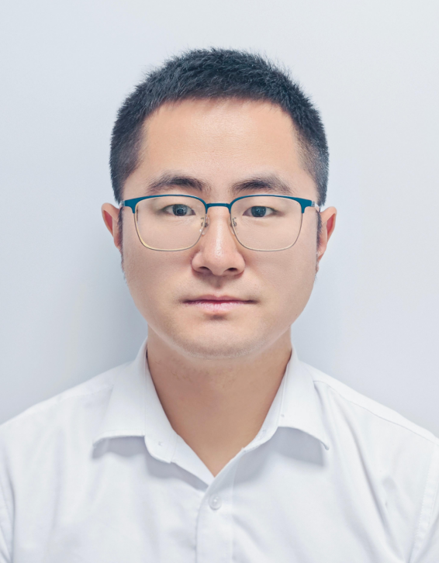
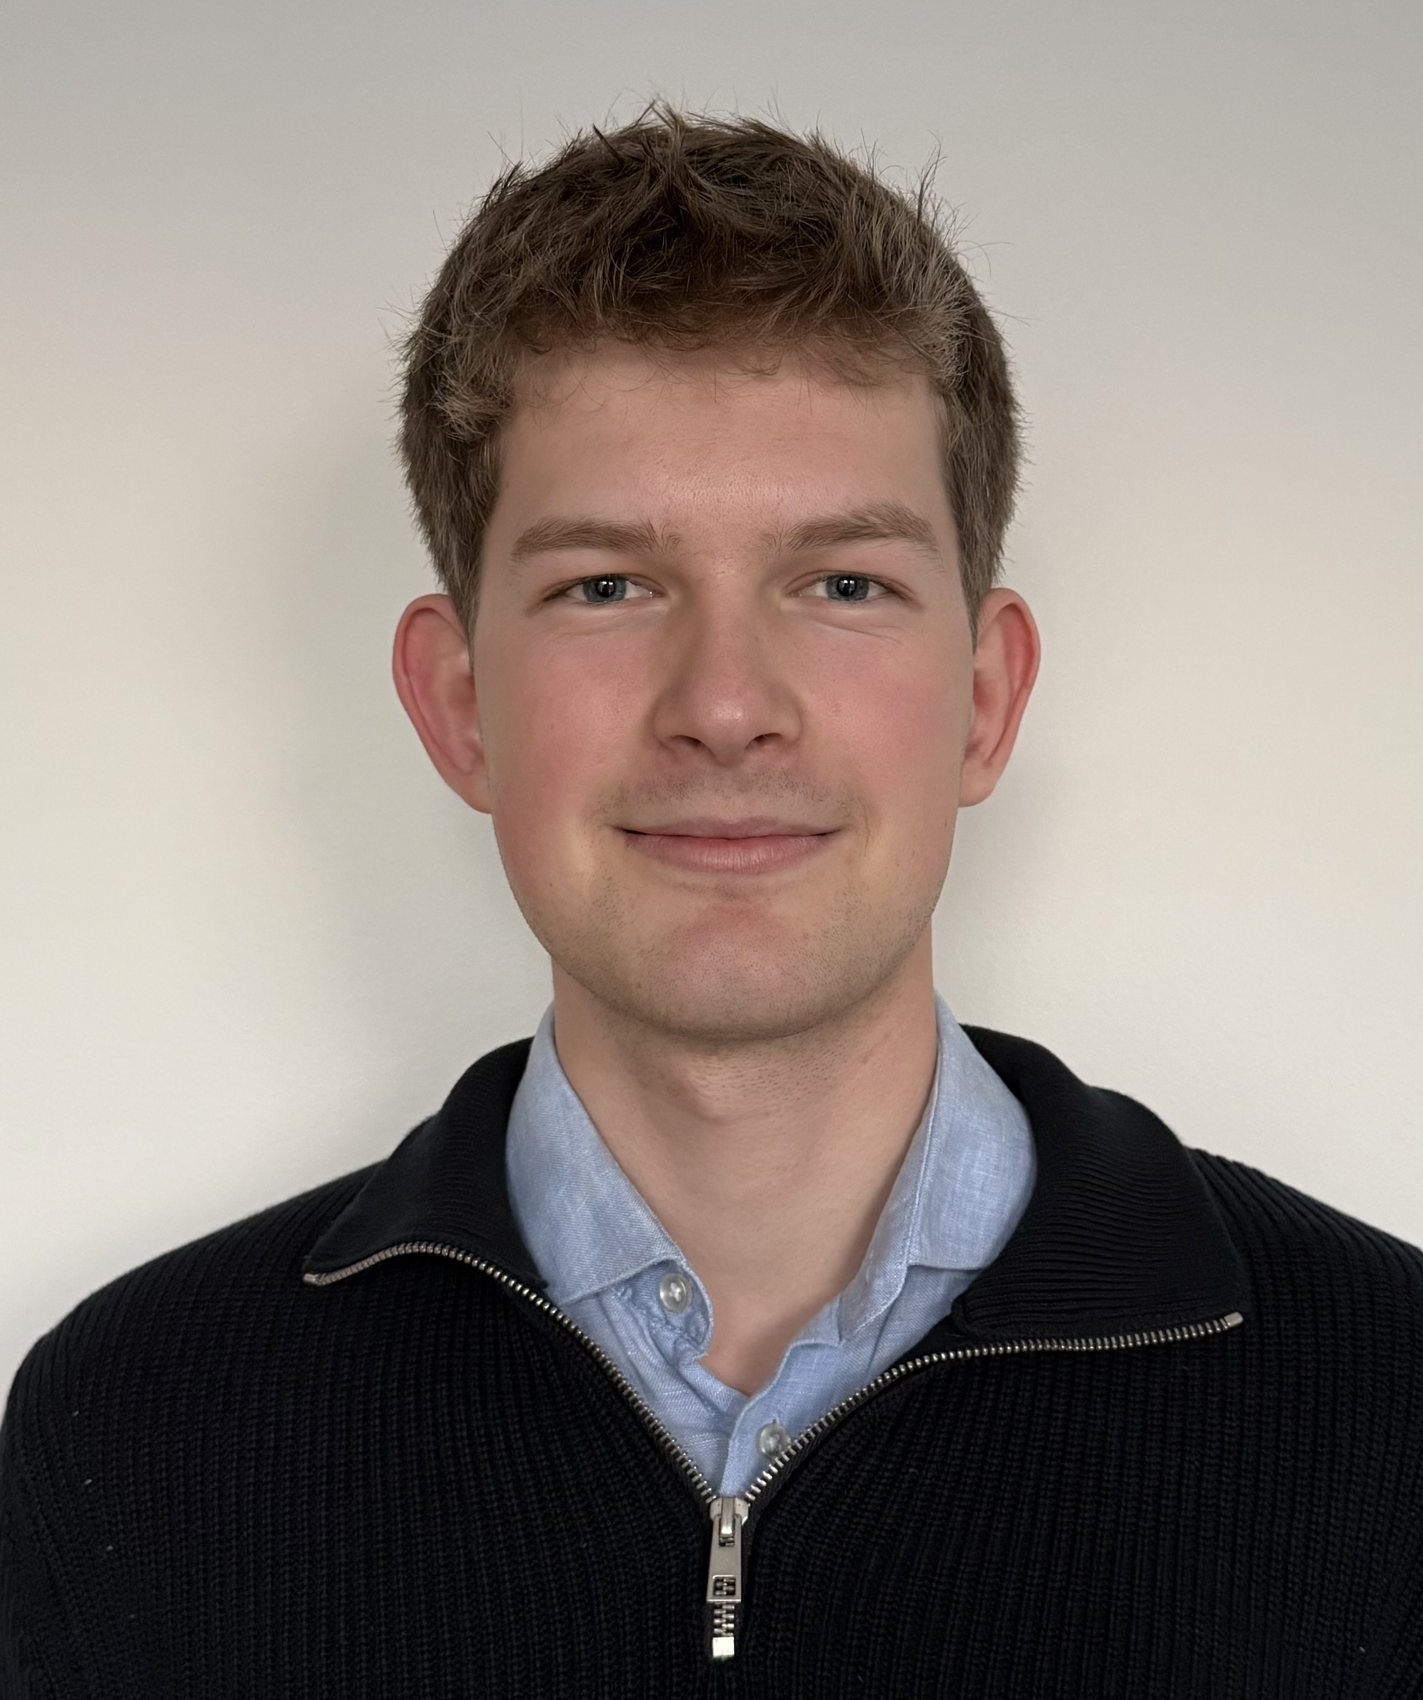
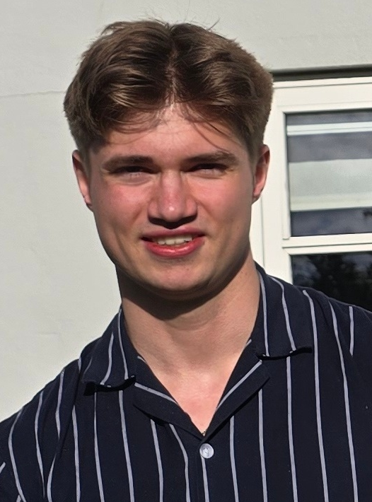
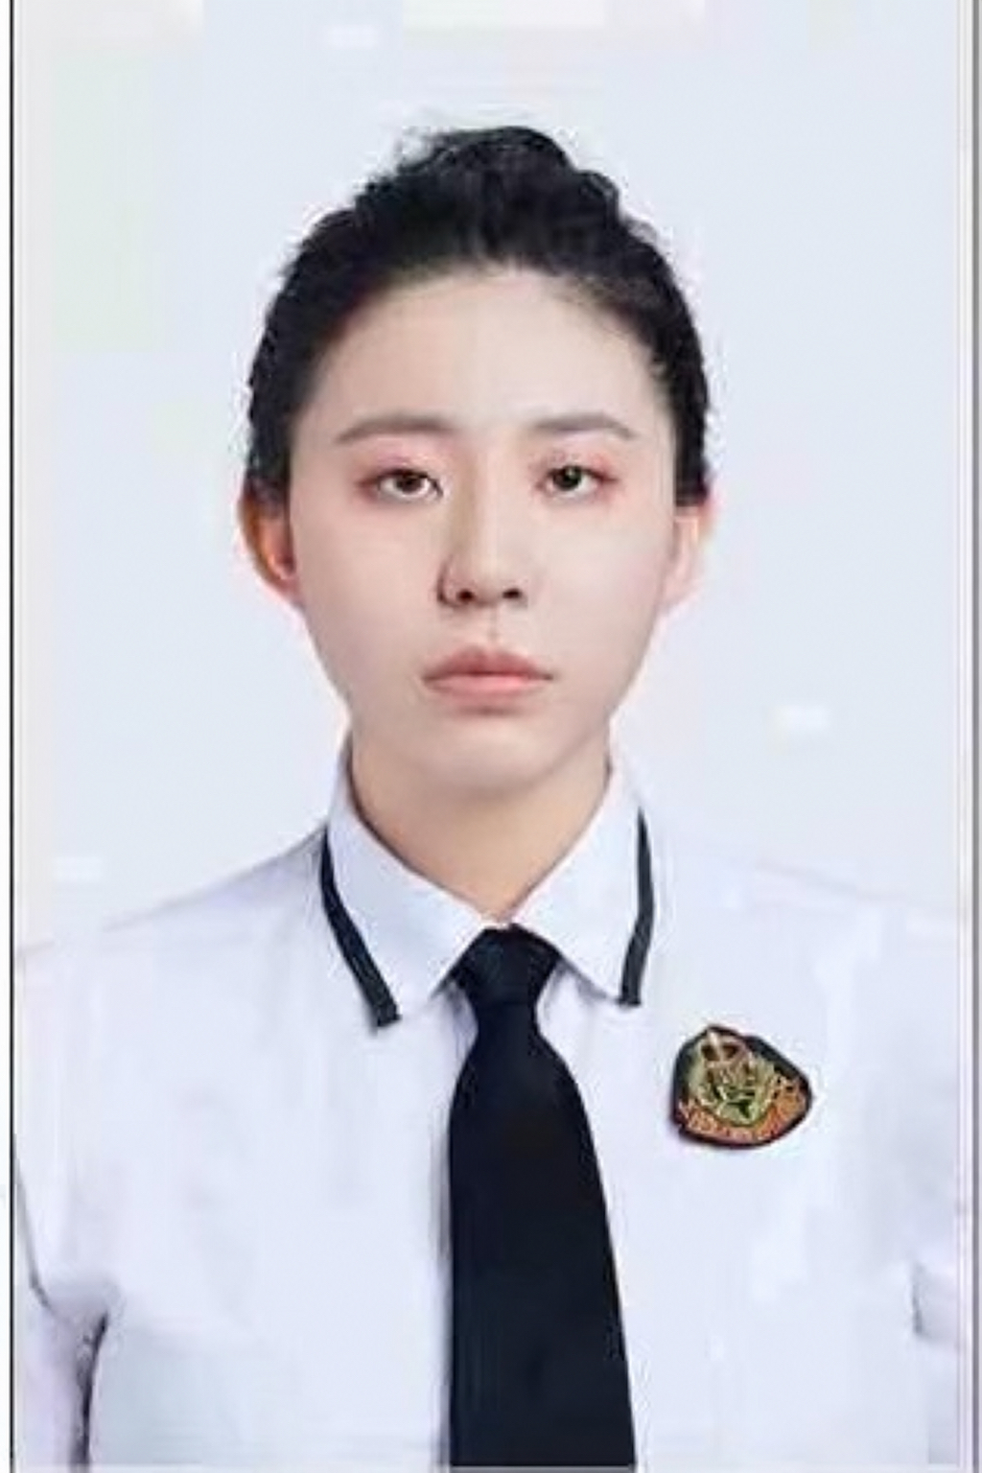
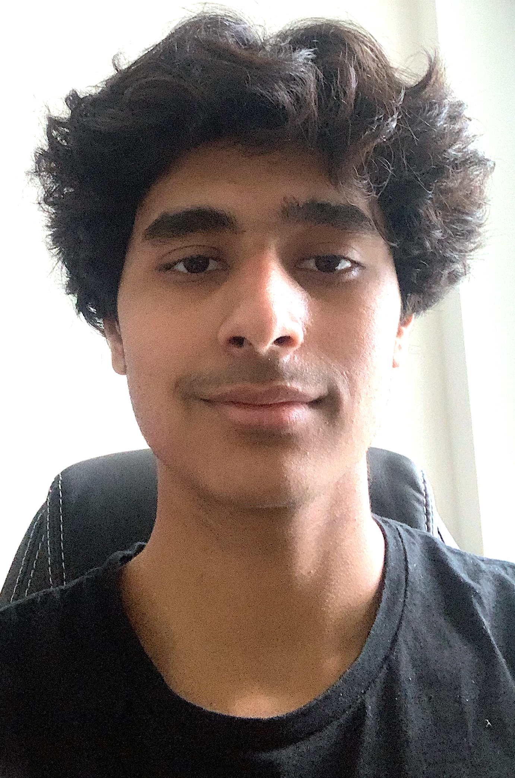
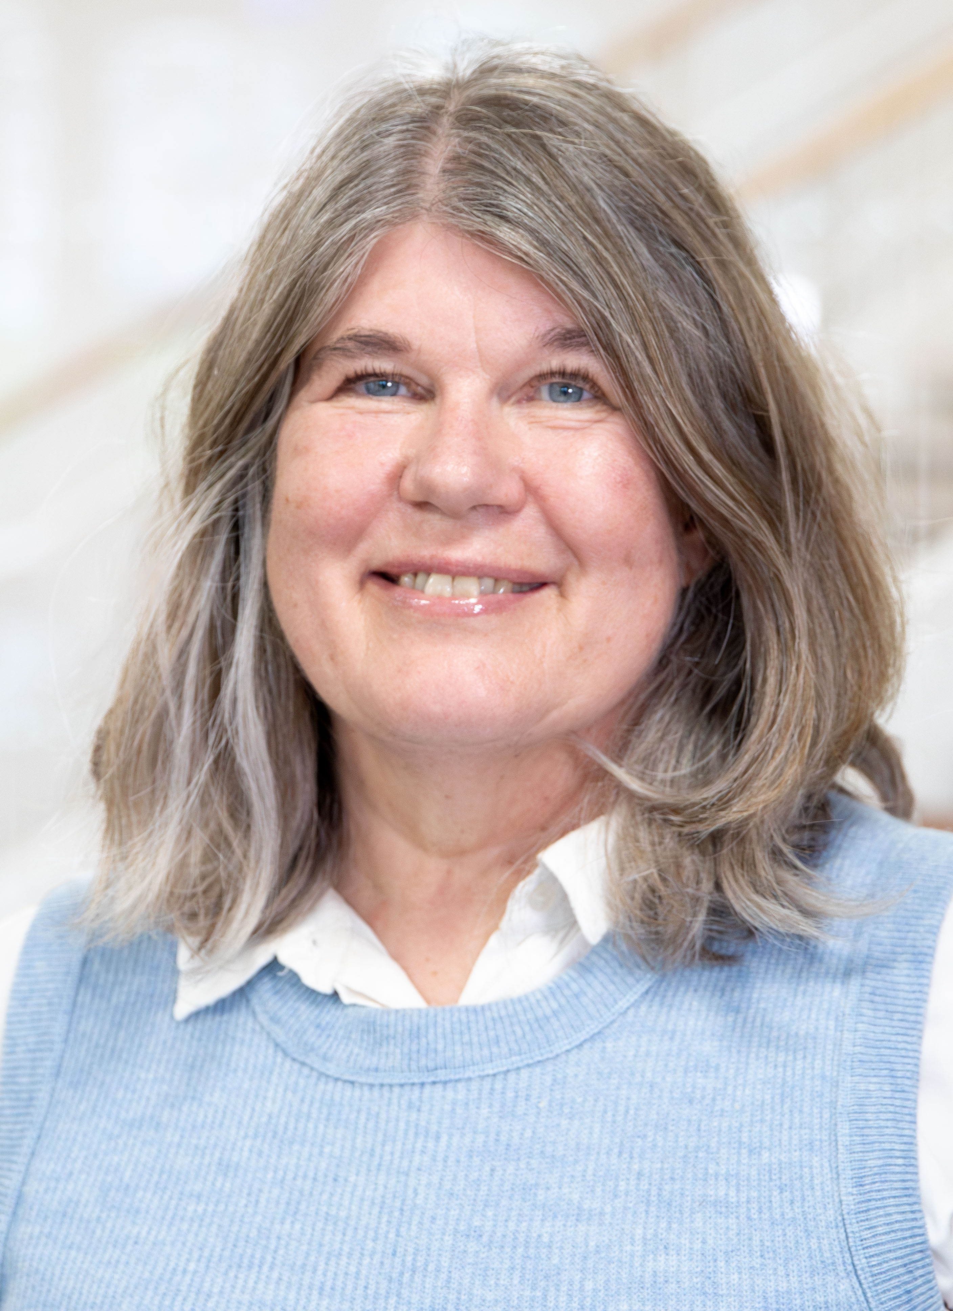
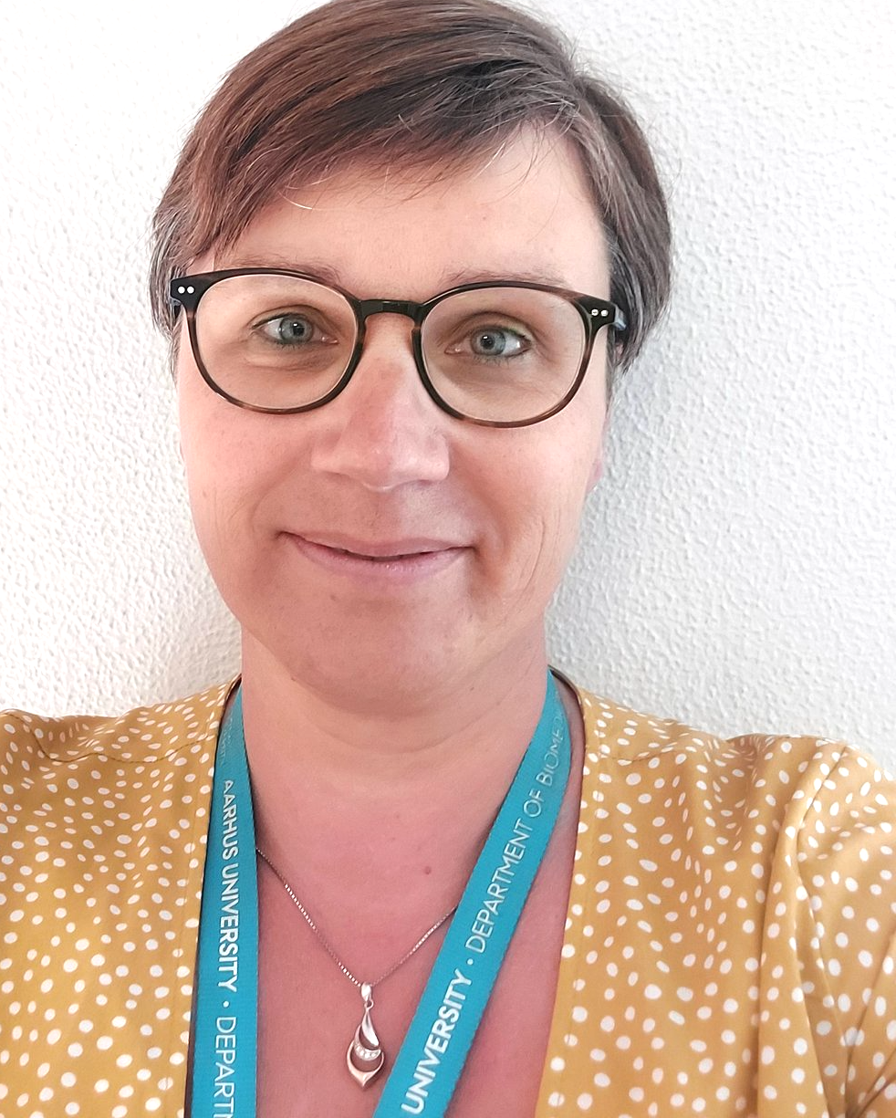
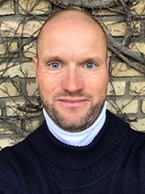
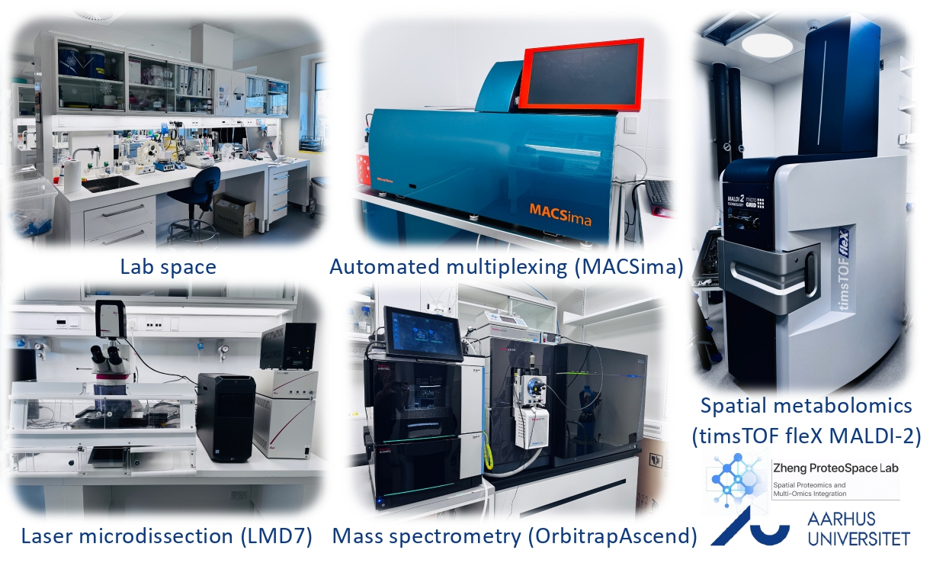
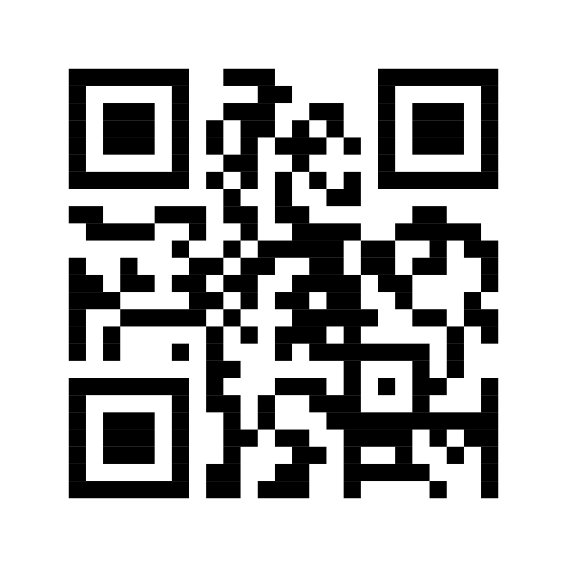

Zheng Lab
My independent research group at Aarhus University
Backed by a LEO Foundation starting grant (12 million DKK)
Research focus: Spatial Proteomics → Precision Oncology & Dermatology
Looking to connect with future PhD students, Postdocs & Collaborators
Our Group’s Research Infrastructure
Postdoc
Dr. Qu Xu
Research trainees
Gustav Graugaard Hansen
Magnus Bæk Bundgaard
Yida Wang
Samyak Suri
Technical staff
Inger Merete S. Paulsen
Cassandra Bennetzen
Tina Drejer
Christian V. Westberg

